Slide 1

Road Accident Analysis
Presented By:-Ankit Rajak
Project File:-
Road Accident Project File

Slide 2

Introduction:-
Road accidents are a significant global issue, contributing to a high number of fatalities, injuries, and economic losses each year. The primary causes include speeding, distracted driving, drunk driving, and poor road infrastructure, all of which pose serious risks to road users. This project aims to analyze road accident data to identify key factors that contribute to accidents, such as time of day, weather conditions, vehicle types, and driver behavior.
Through comprehensive data analysis, this project seeks to provide insights that can help in developing targeted interventions and policies to improve road safety. By understanding the patterns and trends of accidents, it will be possible to make informed decisions that reduce the frequency and severity of road incidents. The ultimate goal of this project is to contribute to safer roads by informing policymakers, road users, and traffic authorities, promoting better driving practices, and improving infrastructure to minimize road accident risks.

Slide 3
Objective:-
Road accident analysis involves examining various factors that contribute to accidents, such as human error, vehicle conditions, and environmental influences. Human factors, like distracted driving, speeding, or impaired judgment, are leading causes. Vehicle-related issues include mechanical failures or design flaws. Environmental factors like poor road conditions, weather, and inadequate signage also play significant roles. By studying accident data, patterns can be identified to improve safety measures, such as enhancing road infrastructure, enforcing stricter traffic laws, and raising public awareness. The goal of such analysis is to reduce accidents, prevent fatalities, and enhance road safety for all users.

Slide 4

Key Questions:-
1.What Is The Cause Of accidents?
2.Find Out The Number Of Accident By Country?
3.Find Out The Accident Distribution By Location?
4.How many Number of Injuries by Country?
5.Accident Distribution by Age Group.
6.Find Out The Accident Severity?
7.Find Out The Total Economic Loss by Country?

Slide 5
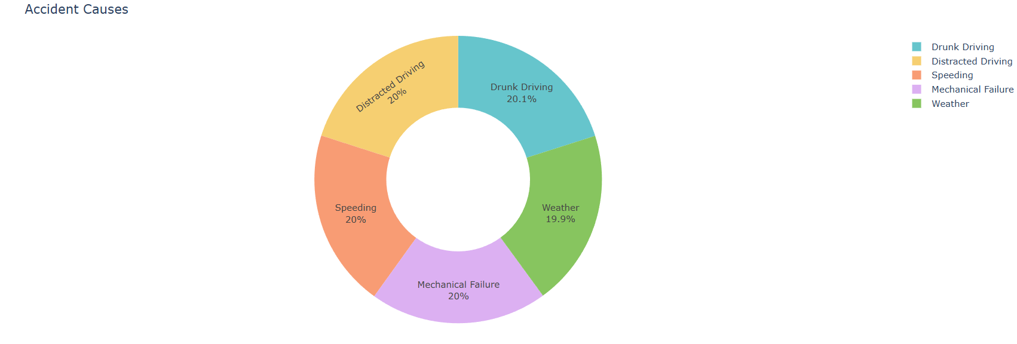
1.What Is The Cause of accidents?
Observation:-The primary causes of accidents include human errors (such as distracted driving, speeding, and intoxication), vehicle malfunctions, and environmental factors like poor road conditions, bad weather, and inadequate signage, all contributing to road mishaps and coll.

Slide 6
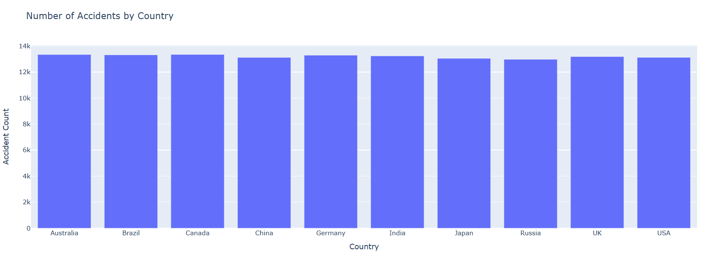
2.Find Out The Number Of Accident By Country?
Observation:- The number of accidents varies significantly by country, depending on factors like population size, infrastructure, and traffic laws. High-accident countries often include India, China, and the U.S., while countries with stricter regulations like Sweden have lower accident rates.

Slide 7

3.Find Out The Accident Distribution By Location?
Observation:-Accident distribution by location often shows higher rates in urban areas due to dense traffic and intersections. Rural areas, though less congested, may experience severe accidents due to higher speeds and delayed emergency responses. Highways and busy junctions are common hotspots.

Slide 8
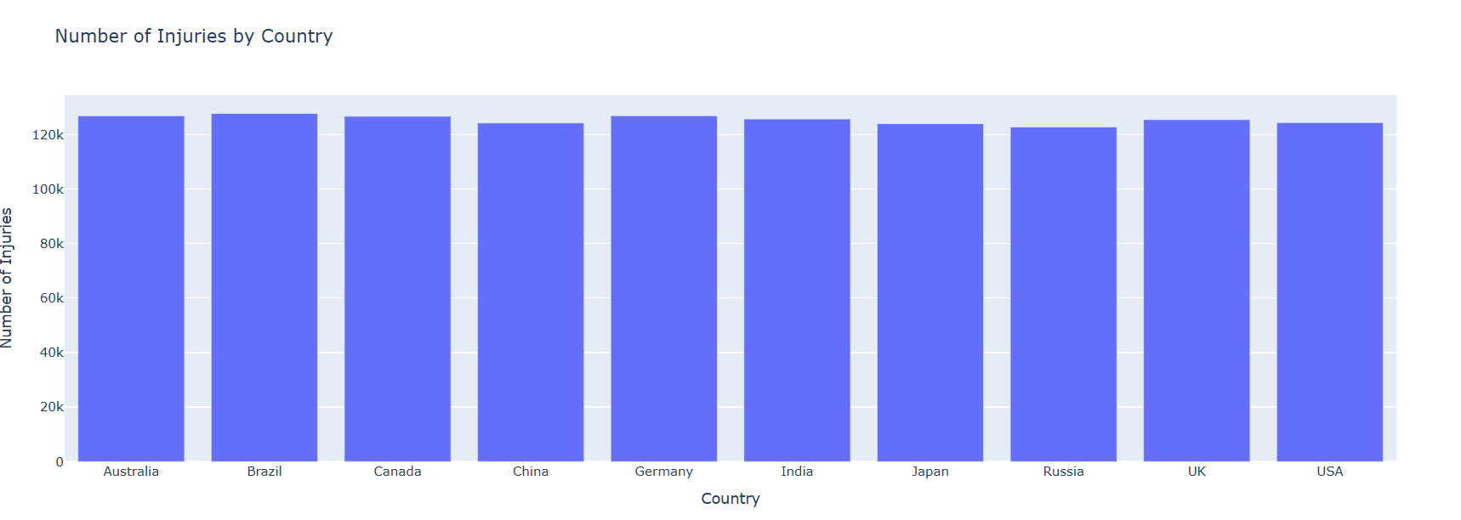
4.How many Number of Injuries by Country?
Observation:-The number of injuries from road accidents varies by country. High-population nations like India, China, and the U.S. report millions of injuries annually, while countries with strict traffic laws, such as Sweden or Norway, have significantly lower injury rates.
Observation:-

Slide 9
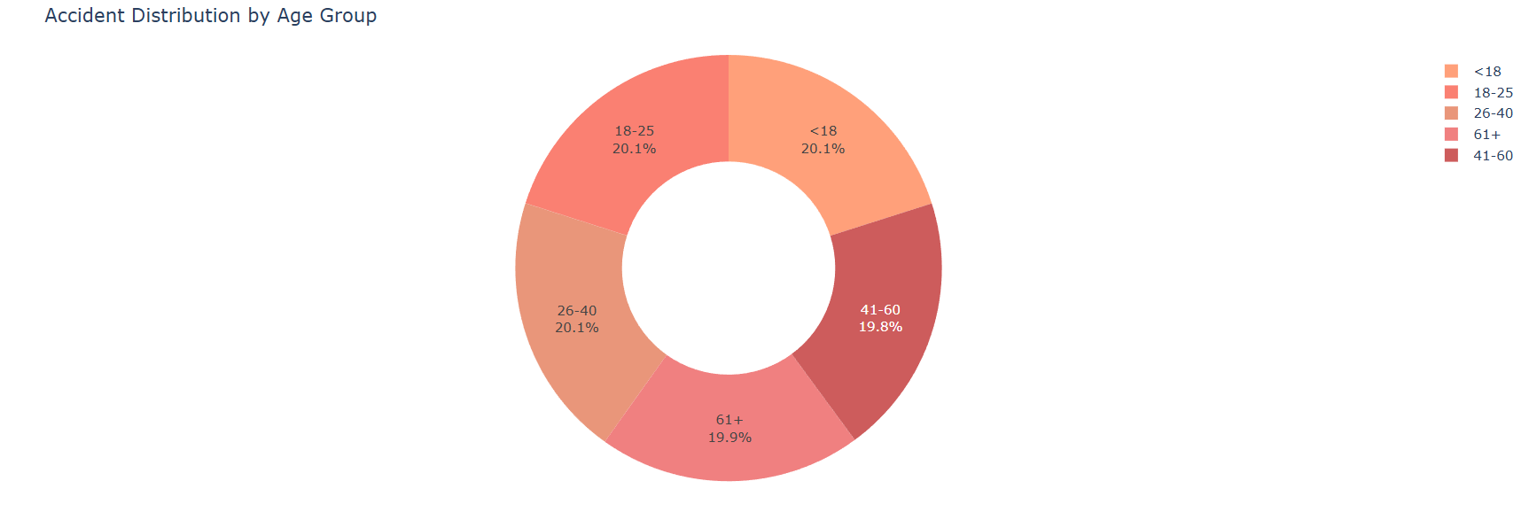
5.Accident Distribution by Age Group.
Observation:-Accident distribution by age group typically shows higher rates among young drivers, especially those aged 18-25, due to inexperience and risk-taking behaviors. Elderly drivers (65+) also face increased accident risks due to slower reaction times, while middle-aged drivers often show lower rates.

Slide 10
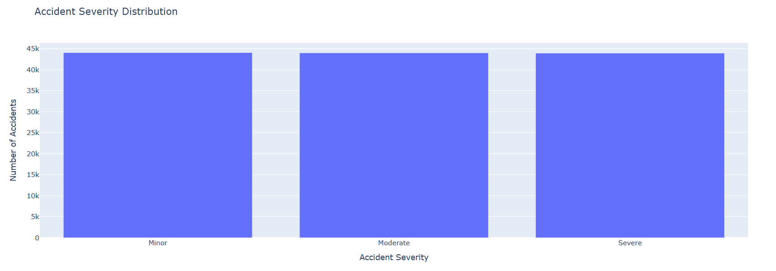
6.Find Out The Accident Severity?
Observation:-Accident severity is determined by factors such as vehicle speed, collision type, and safety measures. High-speed crashes and head-on collisions typically result in severe injuries or fatalities, while low-speed accidents or those involving proper restraints often lead to minor injuries.

Slide 11
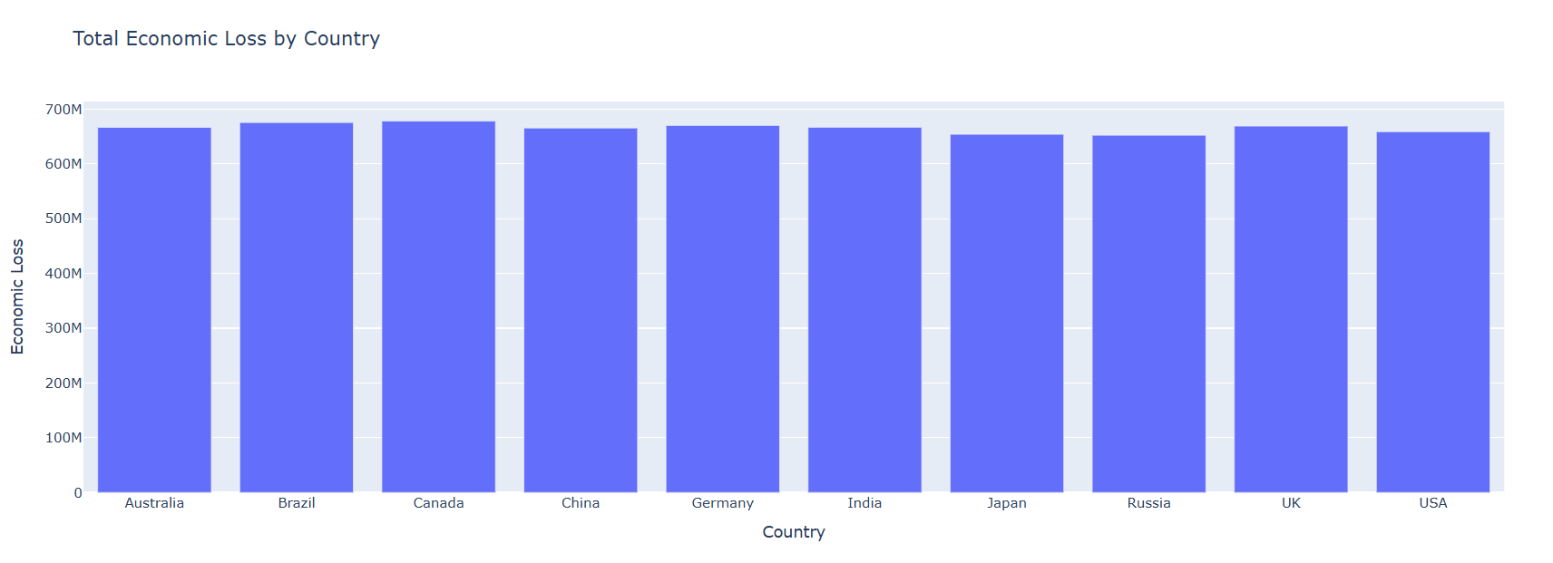
7.Find Out The Total Economic Loss by Country?
Observation:-Total economic loss from accidents varies by country, with high-population nations like India, China, and the U.S. facing losses in billions due to medical costs, lost productivity, and infrastructure damage. Countries with better safety measures experience lower economic impacts.

Slide 12

Conclusion:-
In conclusion, road accident analysis is crucial for understanding the multifaceted causes and consequences of traffic collisions. By examining factors such as human behavior, vehicle conditions, environmental influences, and accident distribution by location, age group, and severity, we can identify key areas where improvements are necessary. Human errors like distracted driving, speeding, and impaired judgment remain the leading causes, while vehicle malfunctions and poor road infrastructure also contribute significantly.
Analyzing accident patterns by location reveals that urban areas tend to have more frequent accidents due to congestion, while rural areas experience fewer but often more severe incidents. Young drivers, especially those between 18-25 years old, are more prone to accidents due to inexperience, while older drivers face risks due to slower reflexes.
The economic impact of road accidents is staggering, with billions of dollars lost annually in countries with high accident rates. These losses stem from medical expenses, lost productivity, and property damage. Through improved traffic laws, better road infrastructure, public awareness campaigns, and technological advancements in vehicle safety, road accidents can be reduced, saving lives and minimizing economic damage. Comprehensive road accident analysis provides valuable insights for policymakers, urban planners, and the public, fostering safer roads for all.

Slide 13
Thank You So Much

